Slide 1

Tic tac toe using min-max algorithm

Slide 2

SANDEEP REDDY Y NANDINI G PRISHITHA KGN TEJA K BICKEY KUMAR J DHANUSHREE Y
AP21110011538
AP21110011526
AP21110011542
AP21110011553
AP21110011279
AP21110011491

Slide 3

CONTENTS
1.PROBLEM STATEMENT
2.FORMULATION OF PROBLEM STATEMENT
3.METHOD
4.RESULT
5.CONCLUSION

Slide 4
PROBLEM STATEMENT
Implement an agent that will play a tic-tac-toe game against a human. The agent will try to choose action to maximize the chance of winning the game.

Slide 5
FORMULATION OF PROBLEM STATEMENT
THE FIRST PLAYER CHOOSES ‘X’ AND THE COMPUTER CHOOSES ‘O’ .
IF A PLAYER SUCCEEDS IN DRAWING 3 CONSECUTIVE MARKS EITHER IN HORIZONTAL, VERTICAL OR DIAGONAL WAY THEN THE PLAYER WINS THE GAME OTHERWISE THE GAME DRAWS
THERE WILL BE 3X3 GRID WITH A NUMBER ASSIGNED TO EACH OF THE 9 CELLS.
THE OUTCOME OF THIS GAME IS EITHER A WIN FOR THE COMPUTER OR A TIE.
THE COMPUTER USES MIN-MAX ALGORITHM FOR SELECTING MOVES

Slide 6
Functions
def create_board():
Creates a 3x3 game board for Tic-Tac-Toe and initializes the board with empty spaces represented by '-’.
def display_board(board):
Display_board function displays the board
def user_input(board):
It takes row and column as input to display ‘X’ on the corresponding row and column. the input is given by the user.
def minimax(board, depth, is_max):
Implements the minimax algorithm to determine the best move for the computer player (‘O’) and Recursively evaluates possible moves and assigns a score to each move.
Returns -1 for a win by 'X', 1 for a win by 'O', 0 for a tie, and the respective scores for intermediate states.
def computer_input(board):
The computer selects the best choice by using min-max function and Updates the board with the computer's move ('O').
def check_win(board):
Check if there is a winning combination of symbols on the board.
Returns the winning symbol ('X' or 'O') or None if there is no winner
def check_tie(board):
Checks if the game is a tie by examining if all cells are filled.
Returns True if it's a tie, False otherwise.

Slide 7
Game
• S0 : initial state
• PLAYER(s) : returns which player to move in state s
• ACTIONS(s) : returns legal moves in state s
• RESULT(s, a) : returns state after action a taken in state s
• TERMINAL(s) : checks if state s is a terminal state
• UTILITY(s) : final numerical value for terminal state s
MAX (X) aims to maximize score.
MIN (O) aims to minimize score

Slide 8
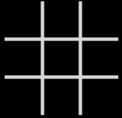
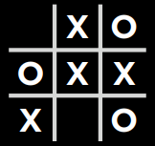

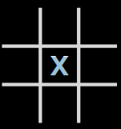
Actions(s)
Players(S)
Player( )= X
Player( )=O
Actions( )={ }

Slide 9
RESULT(s, a)
TERMINAL(s)
O _ _
TERMINAL( O X _) = false
X O X
X _ X
TERMINAL( O X _) = true
X O X
- X O O - - O X O
RESULT( O X X , - - - )=( O X X )
X – O - - - X - O

Slide 10
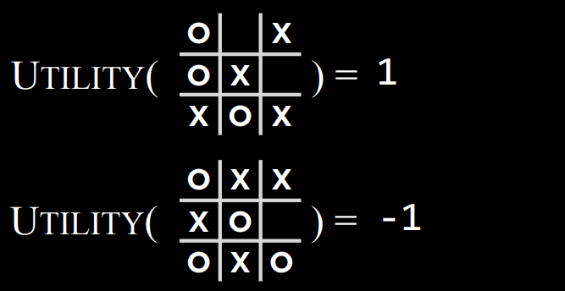
Utility(X)

Slide 11
Minmax Functions
function MIN-VALUE(state):
if TERMINAL(state):
return UTILITY(state)
v = ∞
for action in ACTIONS(state):
v = MIN(v, MAX-VALUE(RESULT(state, action)))
return v
function MAX-VALUE(state):
if TERMINAL(state):
return UTILITY(state)
v = -∞
for action in ACTIONS(state):
v = MAX(v, MIN-VALUE(RESULT(state, action)))
return v

Slide 12
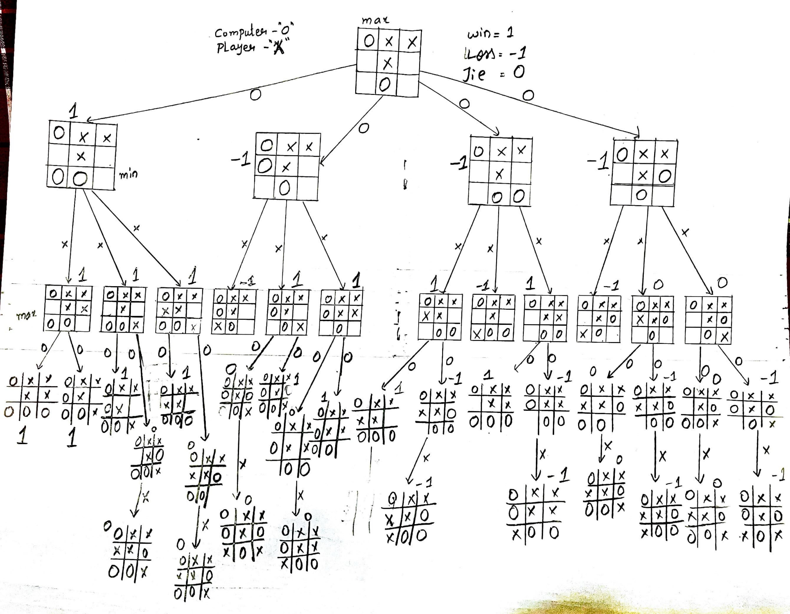

Slide 13
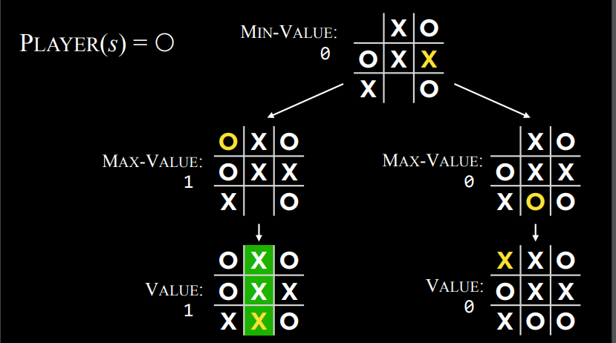
Player(S)=0.

Slide 14
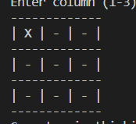
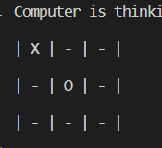
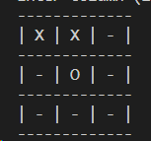
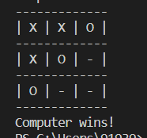
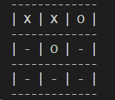
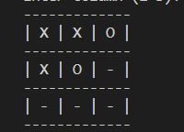
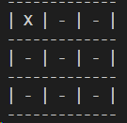
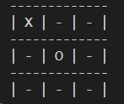
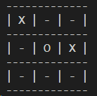
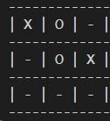
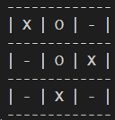
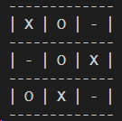
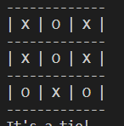
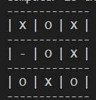
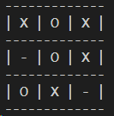
RESULT
CASE-1
COMPUTER WON
CASE-2
TIE GAME

Slide 15
CONCLUSION
Optimal Moves: The Minimax algorithm guarantees optimal moves for the computer player by evaluating the game tree to maximize winning chances or minimize losing probabilities, resulting in strategic and competitive gameplay.
Unbeatable Opponent: When implemented correctly, Minimax algorithm ensures the computer in Tic Tac Toe is unbeatable, anticipating and countering human moves for either victory or a draw, never facing a loss with perfect play.
Computational Complexity: Minimax ensures an optimal strategy but can be computationally demanding in larger games; for Tic Tac Toe's relatively small game tree, it's suitable, but for complexity, optimizations like alpha-beta pruning are needed for practicality.

